Slide 1



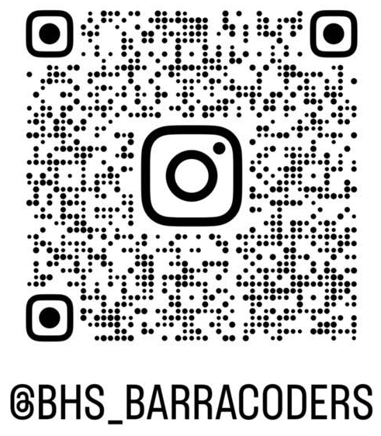
Beachside Barracoders Interest Meeting
Interest Meeting Agenda
Intro to Club/Meet the officers
Rules
Plans for this year
Structure of Meeting
Hackathons
Software
Hack Club Affiliation
Important Announcements
Welcome to the interest meeting for the Barracoders Club 24-25 school year, this PowerPoint will be on our site after the meeting is over.
Important Links:
barracoders.com, hackclub.com, github.com/Barracoders
Next Meeting: 9/26
**Make sure you have a signed permission slip turned in**
barracoders.com
Slide # 1

Slide 2
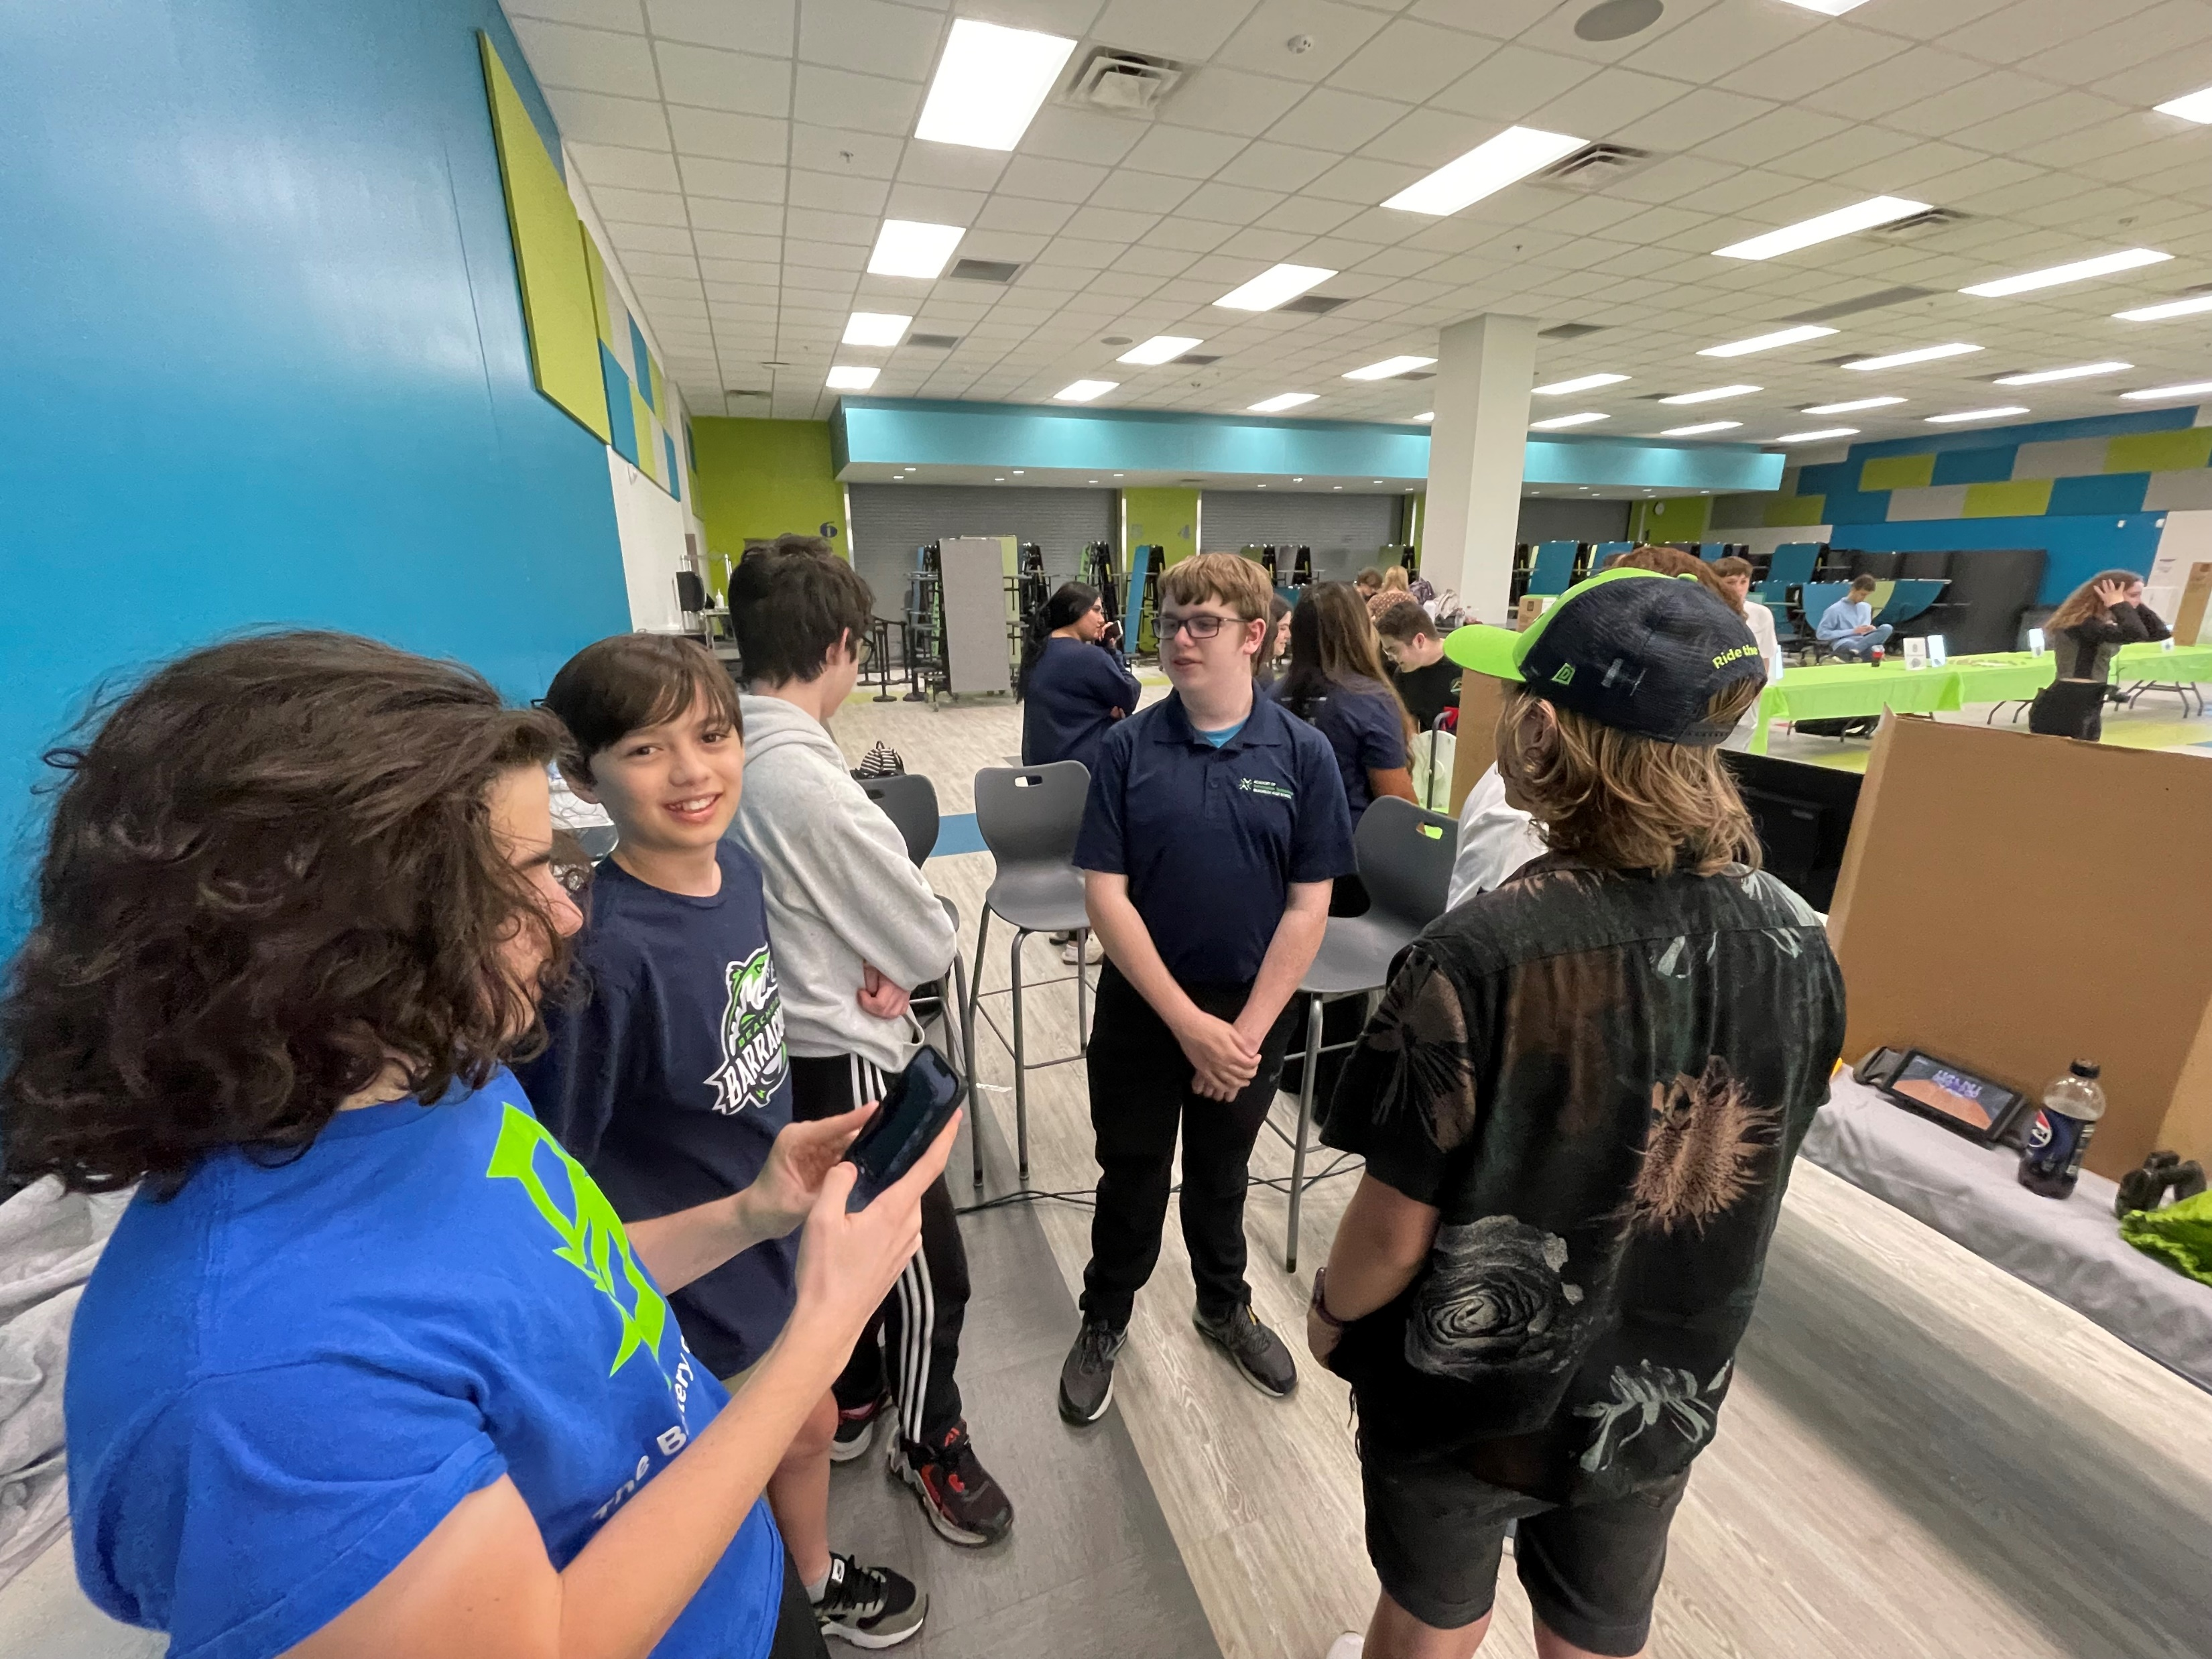
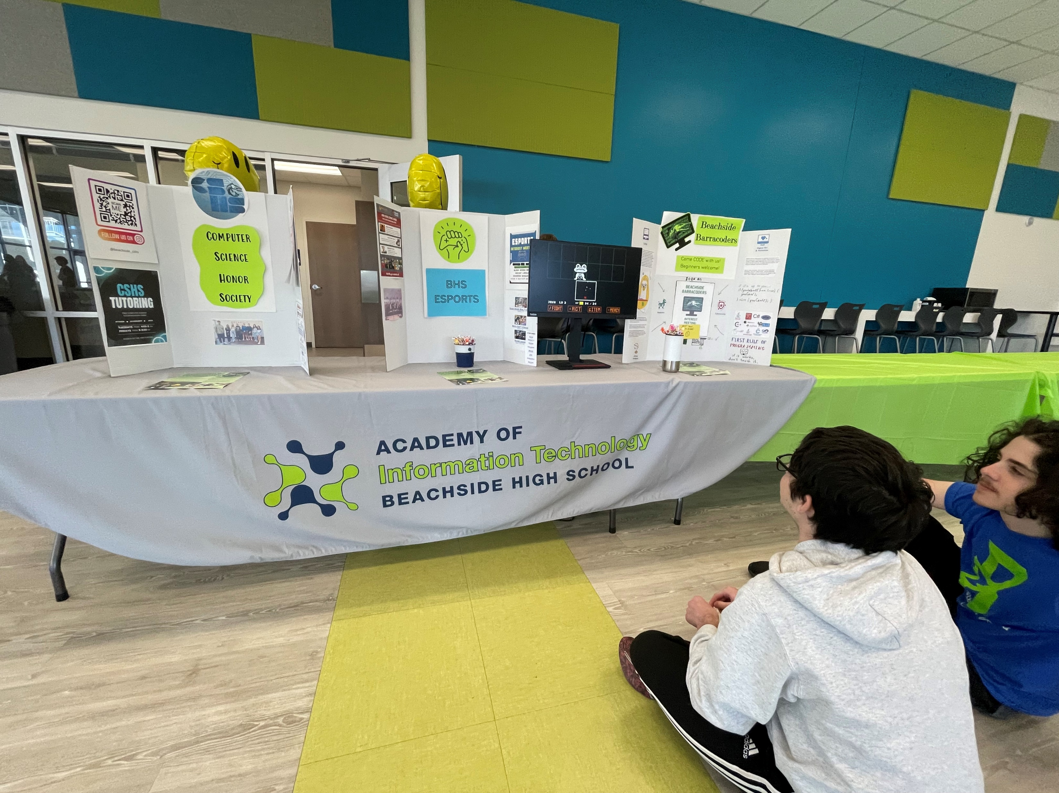

Beachside Barracoders Interest Meeting
About The Club
Barracoders is a vibrant school coding club where students come together to explore the exciting world of computer programming. Members of all skill levels collaborate on projects, learn new coding languages, and participate in competitions. With a focus on creativity, teamwork, and innovation, the Beachside Barracoders foster a supportive environment that encourages students to develop their coding skills while having fun.
Our goal is for people to have fun and make friends while working on coding projects.
Officers
Look at these people having fun (we took no photos last year; we have nothing to show off lol)
President: Josh Worthington
Vice President: Julien Rodriguez-Jaume
Treasurer: Tristian Aflalo
Secretary: Zachary Garland
barracoders.com
Slide # 2

Slide 3

Beachside Barracoders Interest Meeting
Rules
Bylaws
By joining the Barracoders you agree to the Bylaws, Acceptable Use Policy, and the Hack Club Code of Conduct.
barracoders.com/docs/bylaws.pdf
AUP
TL;DR
barracoders.com/docs/AUP.pdf
Treat everyone with respect and kindness
Be thoughtful in how you communicate
Don’t be destructive or inflammatory
Hack Club Code of Conduct
hackclub.com/conduct
barracoders.com
Slide # 3

Slide 4


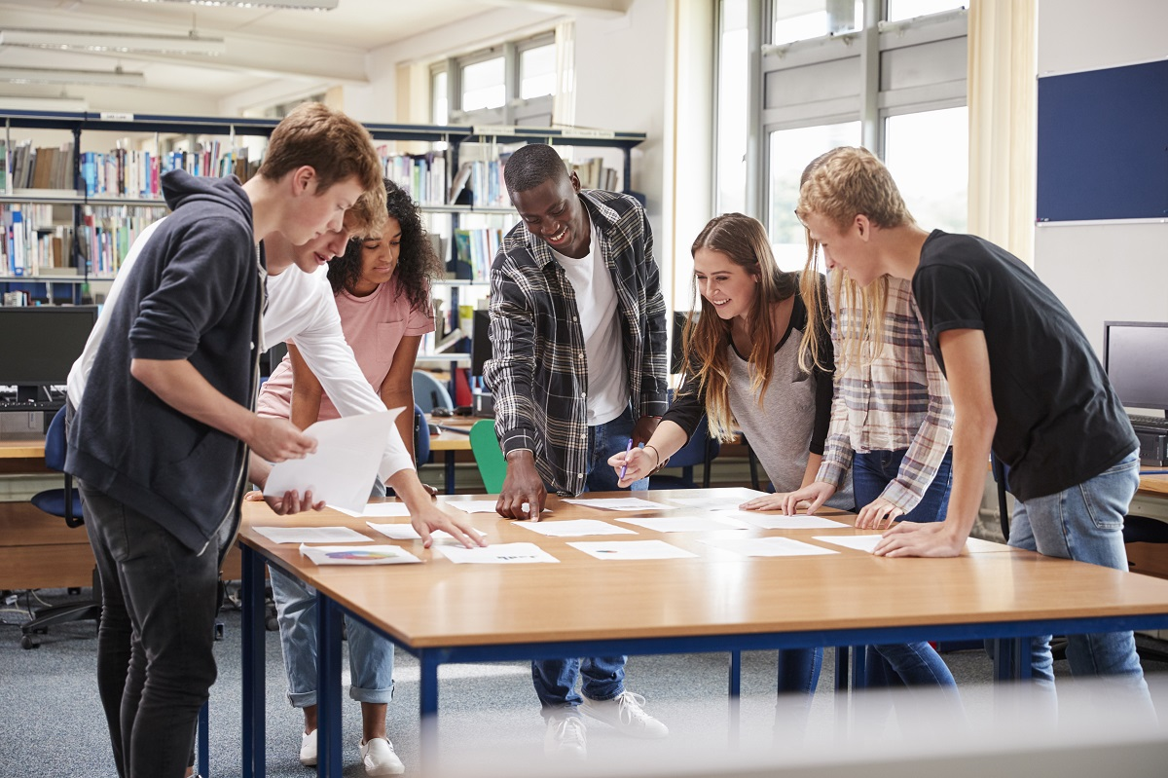
Beachside Barracoders Interest Meeting
Meeting Challenges:
Each meeting there will be a small challenge which everyone will attempt to solve in any way or language.
Group Projects:
Occasionally, we will have a group project, as we work together to build teamwork skills.
Hackathon:
I would like to organize a nice competition open to the entire school, where you follow a prompt to make a full game/program. Could Include prizes, will work out all the fine details eventually.
barracoders.com
Slide # 4

Slide 5



Beachside Barracoders Interest Meeting
Fundraisers/Service Projects:
We are planning to do a fundraiser of some sort to help gets funds for possible field trips, t-shirts, or prize money. Service Projects to help with bright future hours.
Sololearn:
Sololearn is a Duolingo like application that teaches coding instead of languages. Even if you don’t decide to join the club, its worth it checking out the app.
Ethical Hacking:
Ethical Hacking is a fun and exciting thing we want to teach. Includes learning Linux, Kernal Commands, Exploring Vulnerabilities and Networking.
barracoders.com
Slide # 5

Slide 6


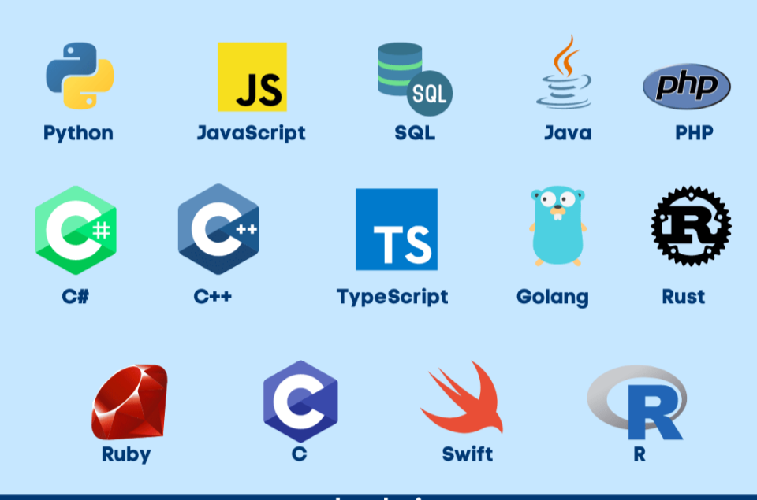
Beachside Barracoders Interest Meeting
End Of The Month Fun:
At the last meeting of each month, we have fun in team building exercises (Jackbox Games), and free code for those who chose not to play.
Guidance:
Guidance through any programming language of your choice to learn. We will help you with almost any language and try our best to teach it along with you
Hack Club Jams:
We are a part of Hack Club international, so we get access to a bunch of resources including Jams, fun projects to do with a little guidance from Hack Club.
barracoders.com
Slide # 6

Slide 7


















Beachside Barracoders Interest Meeting
Languages We Have Resources For
JavaScript
HTML/CSS
TypeScript
Python
Rust
Java
Ruby
C
C#
C++
Swift
SQL
And More
Want a head start?
barracoders.com/resources
barracoders.com
Slide # 7

Slide 8
Beachside Barracoders Interest Meeting
Structure of the Meetings
Meetings Start at 4:05ish and End at 5:00 and will be held every Thursday.
Special Meetings can happen sometimes too, like a holiday party or a special speaker comes in.
If you don’t know when there is a meeting planned, check either the Schoology page or our website.
First 5 Minutes: Opening and Announcements
Next 15ish Minutes: A problem appears on the board, you have 15 minutes to produce a solution in any way, this will help your problem-solving skills and thinking under a time crunch.
Next 40 Minutes: Include either free code where we are available to help you and you can bounce ideas off people, Hack Club Jams, preparation for a hackathon, an organized group project, if we do a lesson on ethical hacking, or if it’s the last day of the month and some Jackbox Games are going.
barracoders.com
Slide # 8

Slide 9
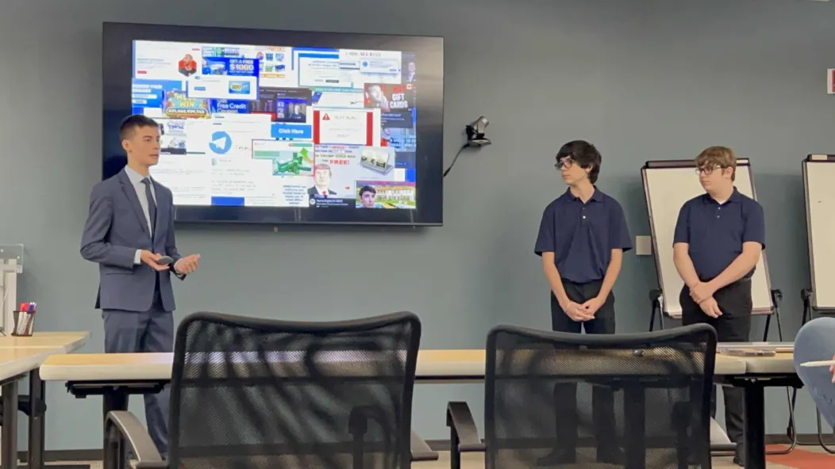

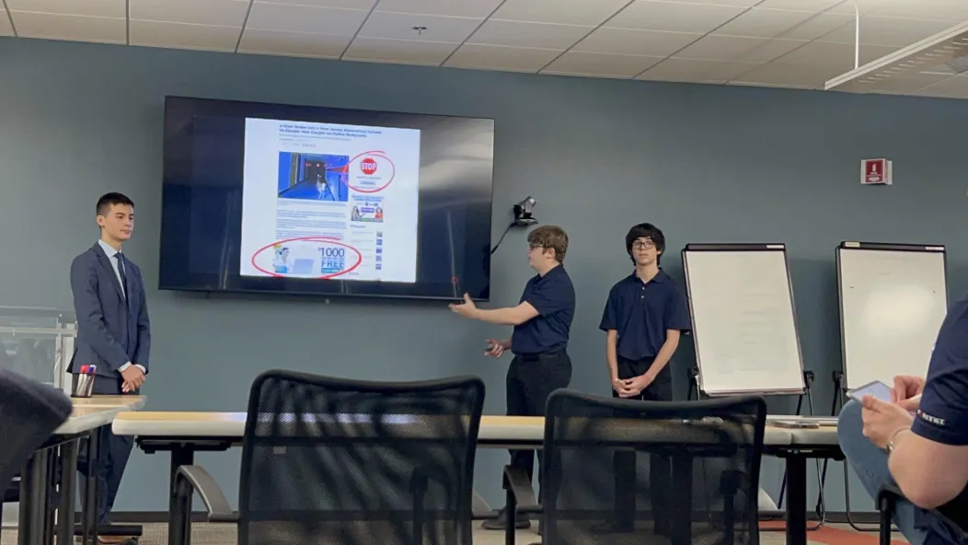

Beachside Barracoders Interest Meeting
Hackathons
We are planning to hold a schoolwide hackathon which we are working on right now, but we also can sign you up and give you resources for other non-Barracoders club run hackathons.
We also get access to a bunch of hackathons with our hack club affiliation, more on that later.
Josh Worthington and
Julien Rodriguez-Jaume presenting our project last year.
CSTA Miami
The CSTA Miami hackathon is a weeklong hackathon in late November and Early December, where you get an open-ended prompt that you need to solve in any way.
CJ also competed with us on our team and did research for us.
barracoders.com
Slide # 9

Slide 10





Beachside Barracoders Interest Meeting
Software
Using for everyone to keep their projects in and can publish them using GitHub pages. Also used for team projects and hosting our website. We have an organization made already.
Sololearn is a platform used to learn programing languages in a Duolingo style, we recommend everyone uses to learn the language they want to. Also has a streak system.
**For Web Developers
A great program for coding websites (HTML/CSS and JavaScript, React, NodeJS, or PHP) and will host them for free with the ending of .glitch.me.
**For Everything else
An online code editor that can display your projects, support a lot of languages including Python, Java, C/C#/C++, Swift, Ruby and much more.
barracoders.com
Slide # 10

Slide 11
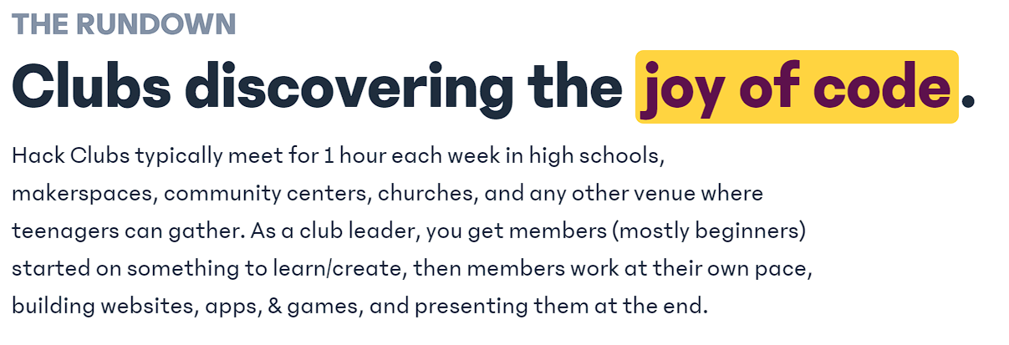
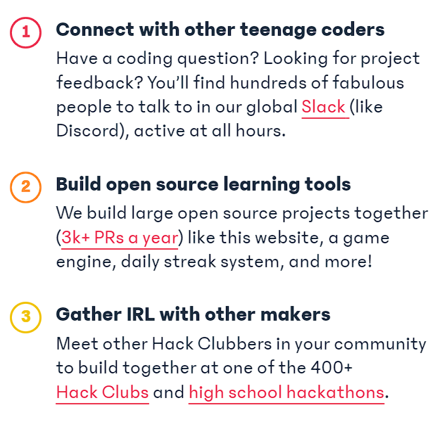
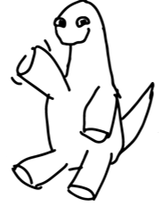
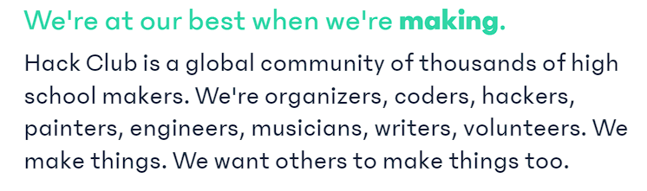
Beachside Barracoders Interest Meeting
Hack Club Affiliation
barracoders.com
Slide # 11

Slide 12
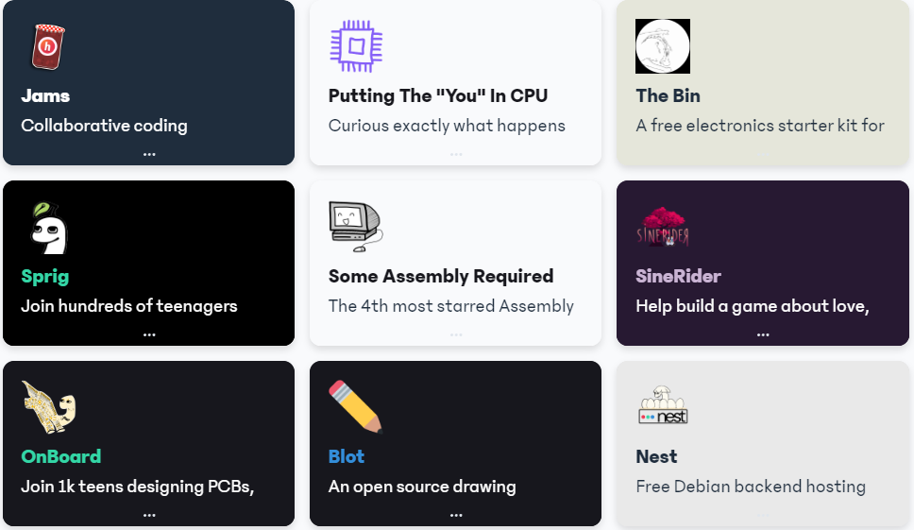
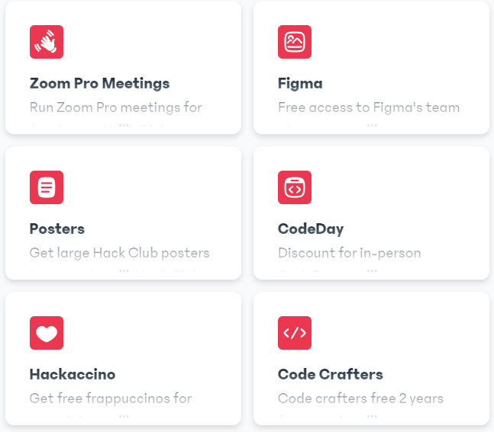
Beachside Barracoders Interest Meeting
Hack Club Perks
barracoders.com
Slide # 12

Slide 13
Beachside Barracoders Interest Meeting
Any Questions?
Please answer our 5 question google form, We want your feedback so you can have the best club experience!
https://forms.gle/4nVoKfDYTLrKzHVJ8
or on
barracoders.netlify.app
barracoders.com
Slide # 13

Slide 14
Beachside Barracoders Interest Meeting
Thank You!
We hope you consider joining our club!
Important Announcements
Thank you for coming to the interest meeting for the Barracoders Club 24-25 school year, this PowerPoint will be on our site in a couple minutes.
Important Links:
barracoders.com, hackclub.com, github.com/Barracoders
Next Meeting: 9/26
**Make sure you have a signed permission slip turned in**
barracoders.com
Slide # 14

